Slide 1


Slide 2

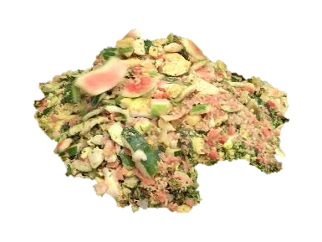

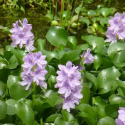
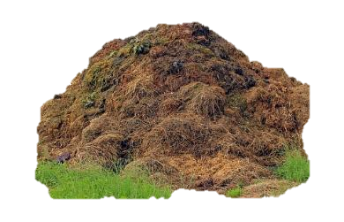
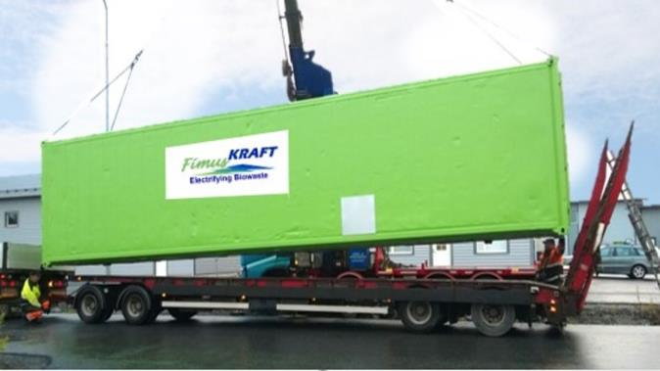
Fimuskraft is a “Seal of Excellence” company of European Innovation Council
Modulaarinen, helposti siirrettävä biokaasureaktori järvien ja vesistöjen kunnossapitoon. Biojätteistä useita
arvovirtoja: energiaa, lannoitefrag-
mentteja, CO2 sidontaa, veden puh-
distus ja hapetus (DO-add), typen
poisto...
[product image]
1

Slide 3
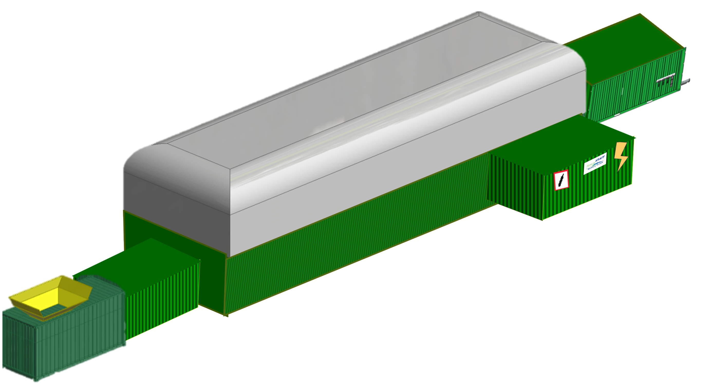
Your problem ------------------ Our solution
Costly handling of biowaste
Too much nitrogen to put on fields (EU-rules)
Soil for grow plants and crops decreasing
Water-hyacinth evaporating sweet water
Lakes and rivers over grown, fish disappear
Pulp mill zero waste- where to put ?
How to get rid of slaughter waste costless ?
How can I get stronger biofertilizer
Biowaste handling is a loss of money
CO2 release costs are high
Pharma/Medicin recidues at Waste water
Modular FKBP for energy and fertilizers, CO2
Fimus Fertilizer enrichment unit
Fimus FKBP making new soil for crops
FKBP modules to turn it energy and fertiliser
Fimuskraft with DO units to heal the waterbasin
Modular FKBP to turn it to energy, gas and soil
FKBP to turn it energy and raw materials
By using Fimus Fertilizer Enrichment unit
Modular FKBP multiple valorising turns it profit
Fimus CO2 washing and catching module
FimusKraft pharma/drugs removal unit

Slide 4

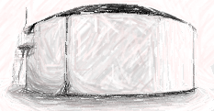
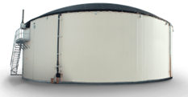
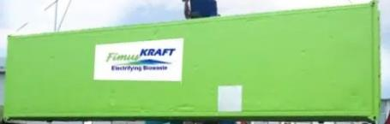

Digester technologies, traditional vs. FimusKraft
Vertical tank mixing, stay-time 40+25 days
Horizontal FIFO process, 22-25 days (<20)
Heavy structure,tanks casted at site
Long building time, 4-12 months
Bulky, because of 6-10 % solids
Fixed, difficult to enlarge
No digestion control, layered bacteria fields
Uneven mixing leads uneven bacteria spread
Chaotic flow, fight against gravity
Low/unhomogenious yield in CO2, fertilizers etc.
Light weight, ready made at factory
Fast build up, 2 weeks
Smaller size, thanks to 15-30 % solids
Modular and flexible, easy to add modules
Controlled digest, even spread of bacteria
Even mixing leads even bacteria spread
Organized flow, FIFO principle
Better/Even yield in all products
Lower cost, space, set-up time
Chaotic unorganized mess
Organized FIFO-flow

Slide 5
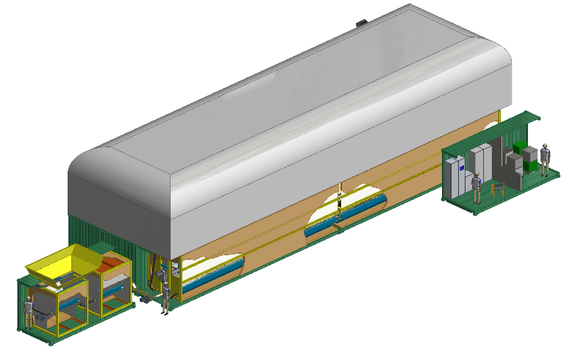
Tulppavirtausreaktori
FIFO periaate
Patentoitu sekoitus
Erinomainen lämmön hallinta
Lyhyt viipymä 22-26päivää
Jopa 70% metaania
Ei rikkivetyä
Modulaarinen ja kompakti
Voidaan käsitellä eri jakeet omilla radoilla tarvittaessa
-FIFO vaakavirtaus, ei painovoima ongelmia
Biokaasuvarasto
Syötteet
TS 10…30%
Ohjaus ja CHP
Bioreaktori
Esikäsittely

Slide 6
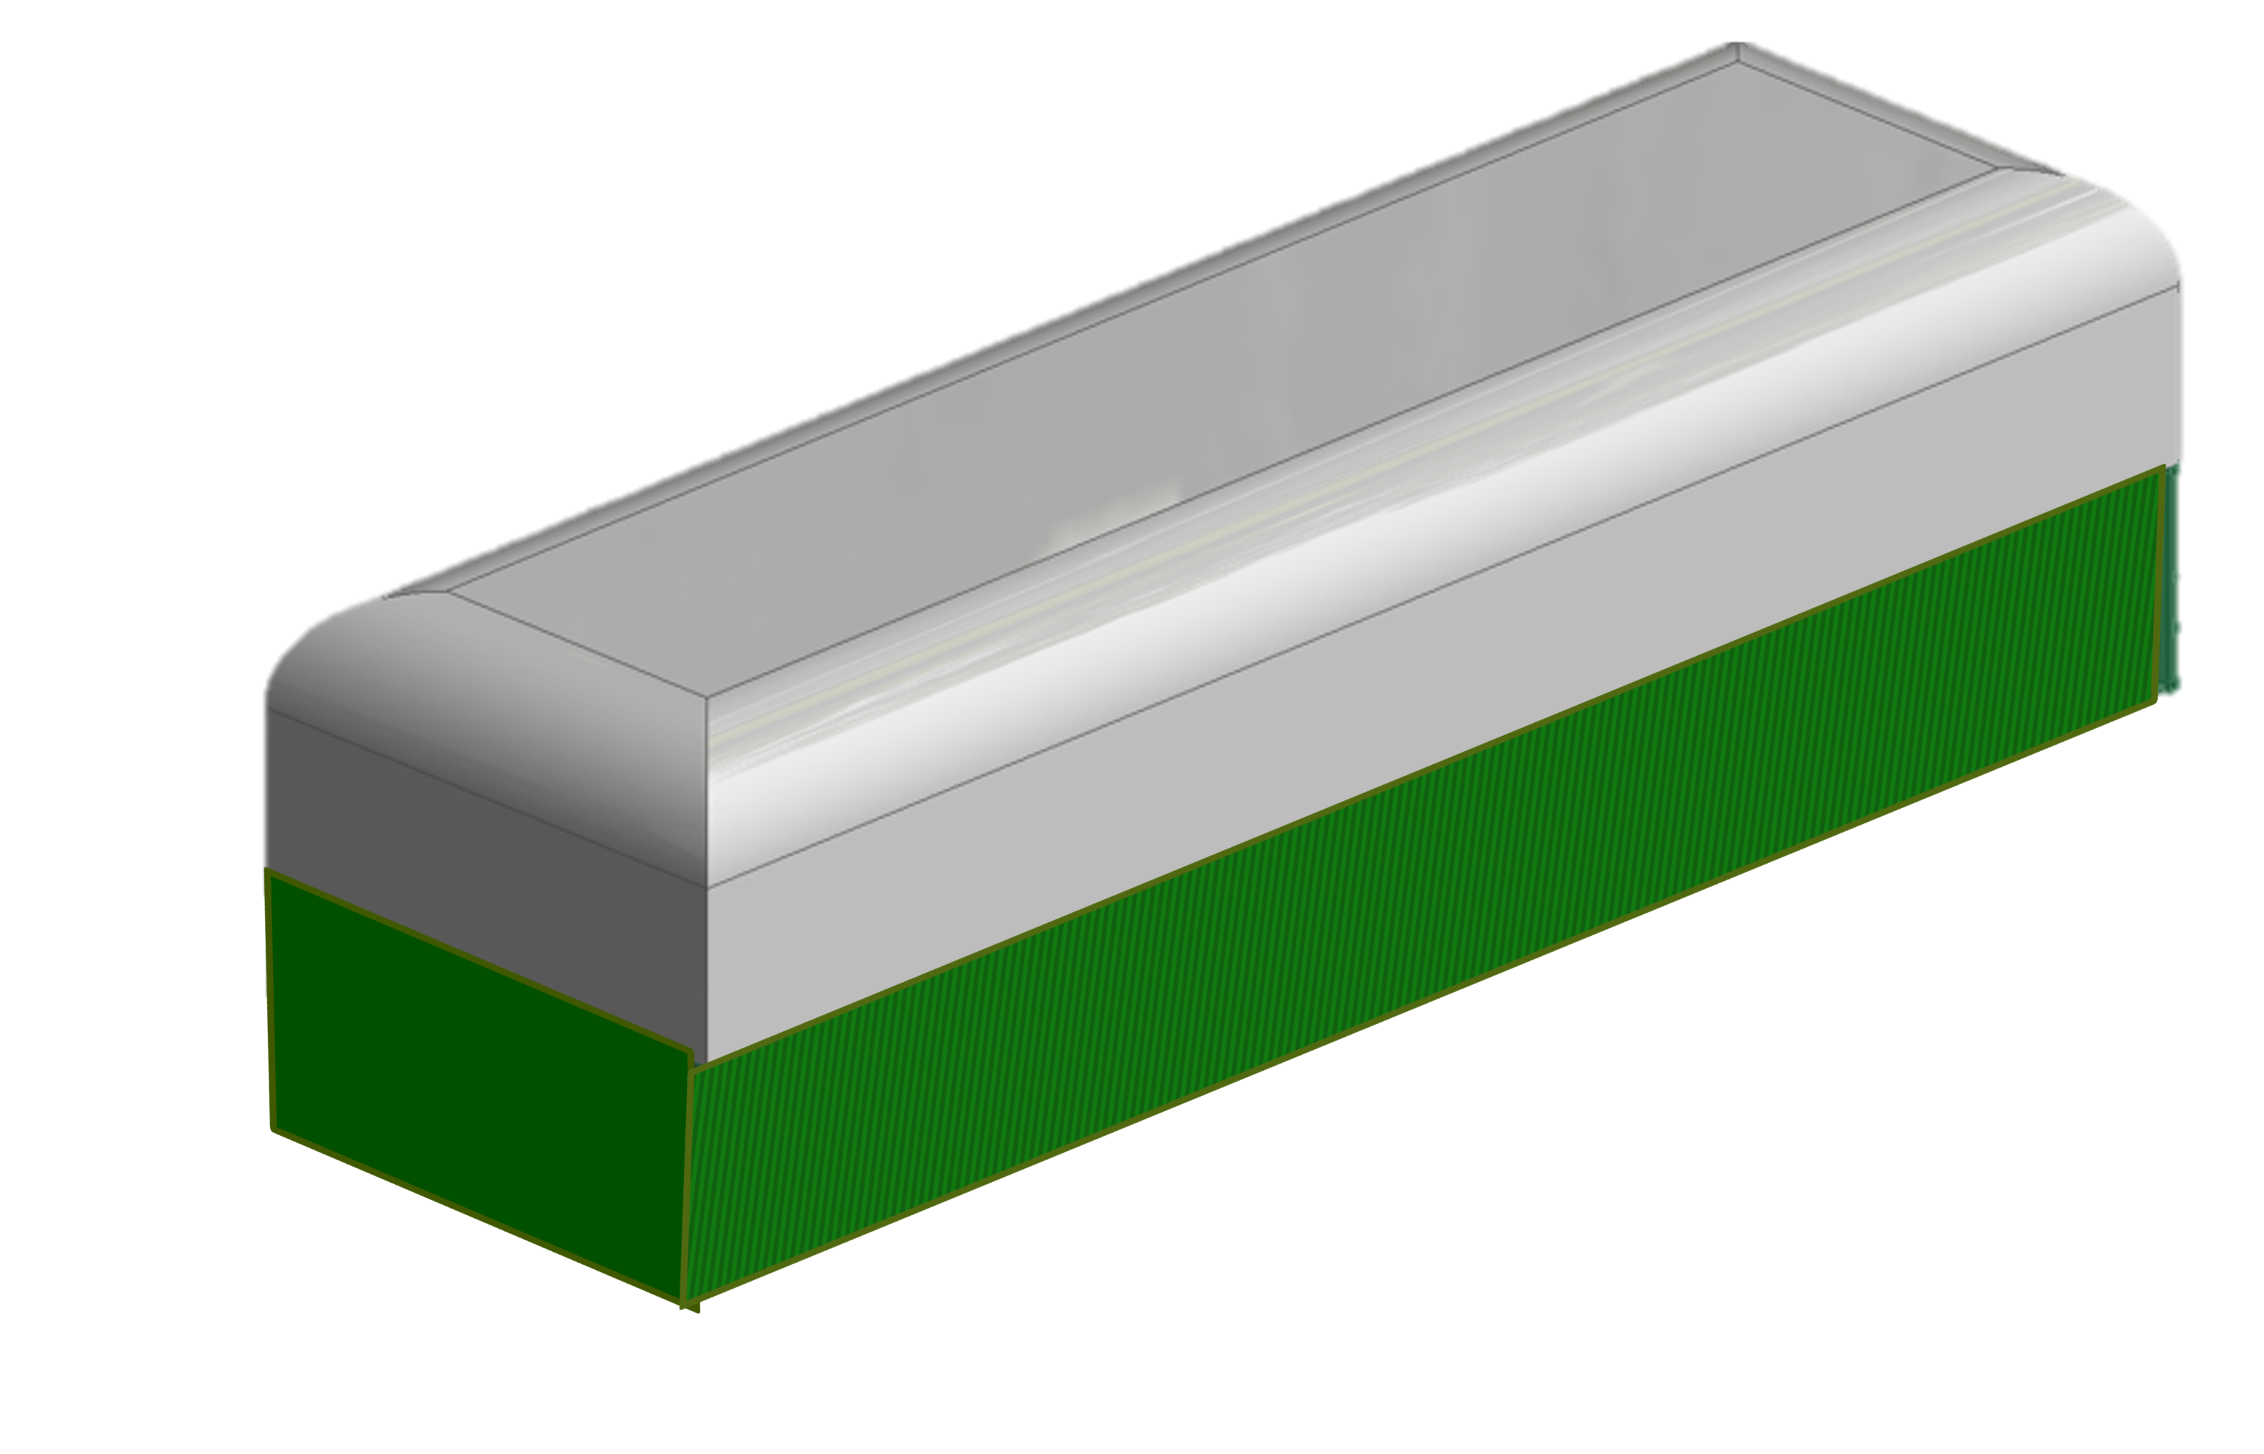
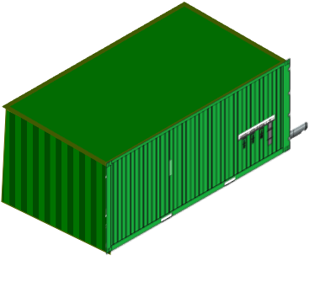
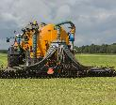
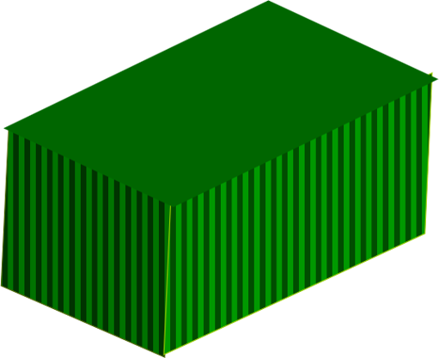
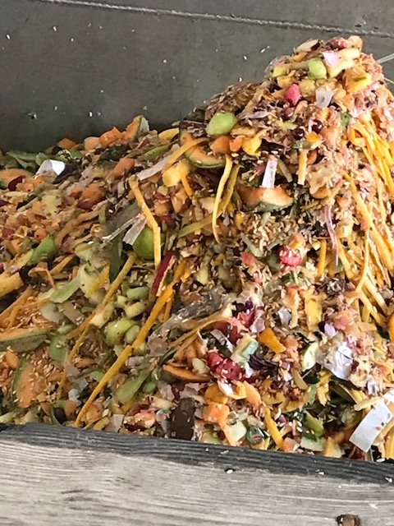


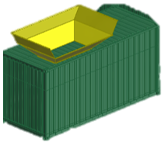
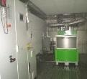
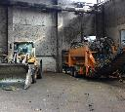
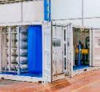

FKBP: Fully automated, modular and compact
Fertilizer enrichment unit
Solids 1%-30%
Biomethane 70% + CO₂
Enriched fertilizer
Irrigation water
Fermented and dry biomass
Enrichment
Biowaste
Biogas storage
Control unit
Fermenter
Energy production
Electricity
Heat
Prehandling
Biogas Production
Stay time 22-26 days
CO₂
Pressurized biomethane
MBU
MBU (Microbiological boostering unit)
Green hydrogen
Raw materials for pharma & chemical industries.

Slide 7
Liukoisen hapen lisäys veteen kunnostuksen yhteydessä
Liukoinen happi on avain indikaattori vesistön puhtauden terveyden suhteen ( oltava noin 6,5 – 7,0 mg/l
tai enemmän)
Voidaan lisätä helposti ja edullisesti järven ruoko- ja kasvustopoiston yhteydessä
FimusKraftin prosessiin helppo lisätä DO:n lisäys laitteisto; helpottaa ja kiihdyttää järven omaa hapen
tuotantoa ja siten tervehtymistä
Seuraavan kalvon esimerkki on DO-systeemistä vedenpuhdistuslaitoksella, siellä tarvitaan prosessiin
DO:ta puhdistus prosessin bakteeristoa varten

Slide 8
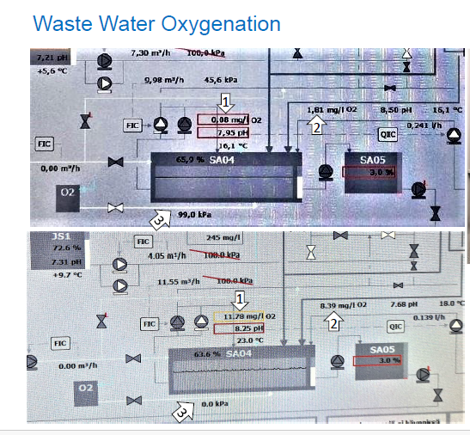
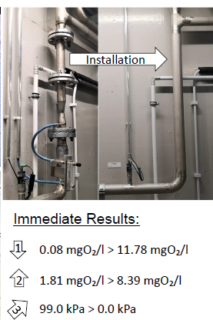
DO (=Dissolved Oxygen) adding to the waste water
Showing the case at Sipoo
WWTP, where dissolved
Oxygen was added to the
Process. Pictures taken
From the computer control
Screen of the process.
Above before and below
After the addition of the
device.

Slide 9
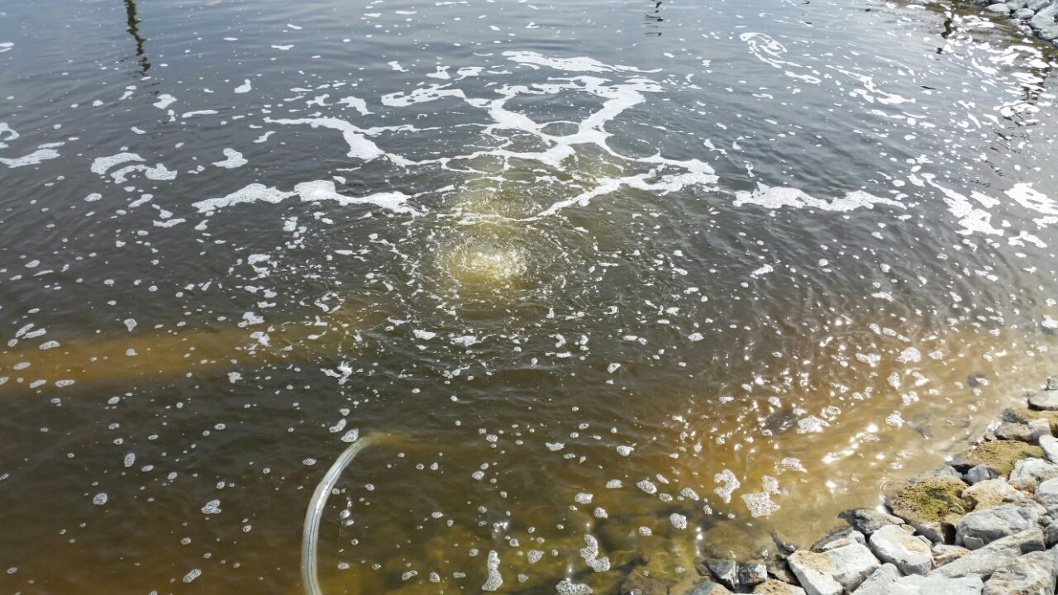
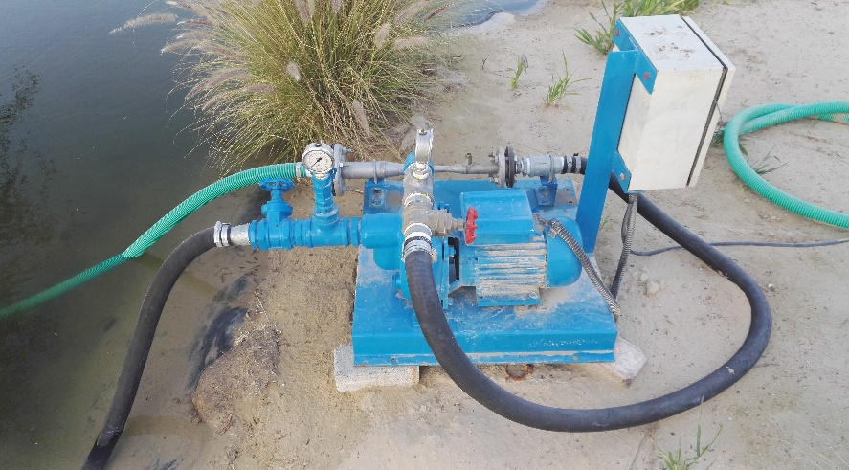
2. Vesistön ilmastus – DO lisäys (Dissolved Oxygen)
Ilmastus (= liukoinen happi) on keskeisin vesistön hyvinvoinnin mittari
Kun liukoisen hapen taso on riittävä, kalat ja muu eläinfauna viihtyy ja vesistö hoitaa itse itseään
Voidaan laittaa osaksi ruoppaus ja niittoprosesseja FimusKraftin teknologialla

Slide 10
FimusKraft Modules
Special
Processes
Biogas storage
Prehandling
Microbiological boostering
Control unit
Zero waste handling Process
Fermenter
Enrichment
Biogas storage
Control unit
Fermenter is fermenting the biowaste and gas produced will stay on storage above the fermenter containers
Organized FIFO principle
Stay time 22-26 days
Biomethane 70% + CO₂
Pre-handling of bio-feed
water/moist removal
mechanical
Special pre-process
MBU Microbiological Boostering Unit
Raw materials for pharma & chemical industries
Green hydrogen
Process Control
Fully automated
Sensor feed-back
Process control and adjust
Fementer
Prehandling
MBU
Zero Waste handling process for Pulp & Paper Industry waste
Lake alive process
Enrichment
Enrichment
Biogas
Cleaning
Biogas
Production
Electricity production
Enrichment
Wastewater Treatment
Biogas storage
Control unit
Enrichment
Fementer
Prehandling
MBU
Lake alive process for cleaning & healing rivers, lakes and seas
Contaminated waters
Water Hyasinth
Other sea/lake/river-weeds
Separation / cleaning of biogas
Purified biomethane
CO₂
Cleaning and pressuring
Biogas production for further use/value add
Electricity production
Electricity
Heat
Fertilizer Enrichment Unit
Enriched fertilizer
Irrigation water
Fermented and dry biomass
Waste-Water Treatment Container
- Cleaning the water for re-use
medical/pharma residues removal
Radon removal
Etc.

Slide 11


Breakthrough CleanTech for Biowaste producers to Enter the Circular Economy
Ahti Koivunen, CEO FimusKraft Ltd. (Finland, Est. 2017) ahti.koivunen@fimuskraft.com +358 50 559 3091
1

